Slide 1
How to Complete a
Graduation Petition
Graduation Office
graduation@sccollege.edu
February 2025

Slide 2
Graduation Petition
Electronic (online) & Paper (A&R, Counseling)
Submit to graduation@sccollege.edu
Deadlines
Fall 24 – October 4th
Spring 25 – March 7th
Summer 25 – June 24th
For more assistance, contact a counselor

Slide 3
When should you submit?
Complete at least 30 units
–or –
One semester before completing:
Associate Degree (AA, AS, AS-T, AA-T)
GE Certification (CSU GE / IGETC)
Certificate of Achievement or Proficiency
Intend to participate in Commencement (June 5th, 2025)

Slide 4
Associate Degree Requirements
Major requirements (C or better)
General Education Pattern
SCC Local GE (Plan A or Plan D or Plan 3)
CSU GE (Plan B)
IGETC (Plan C)
Cumulative GPA 2.0 or higher
12 unit residency @ SCC
(AA,AS – 6 units in major)
60 unit requirement
(AA/AS – degree applicable, AA-T/AS-T - CSU transferable)

Slide 5
CAUTION – Academic Renewal
Inasmuch as past performance does not
always reflect accurately a student’s actual ability
…Without Course Repetition (RWO)
…With Course Repetition (TRR)
…With Course Repetition AB705

Slide 6
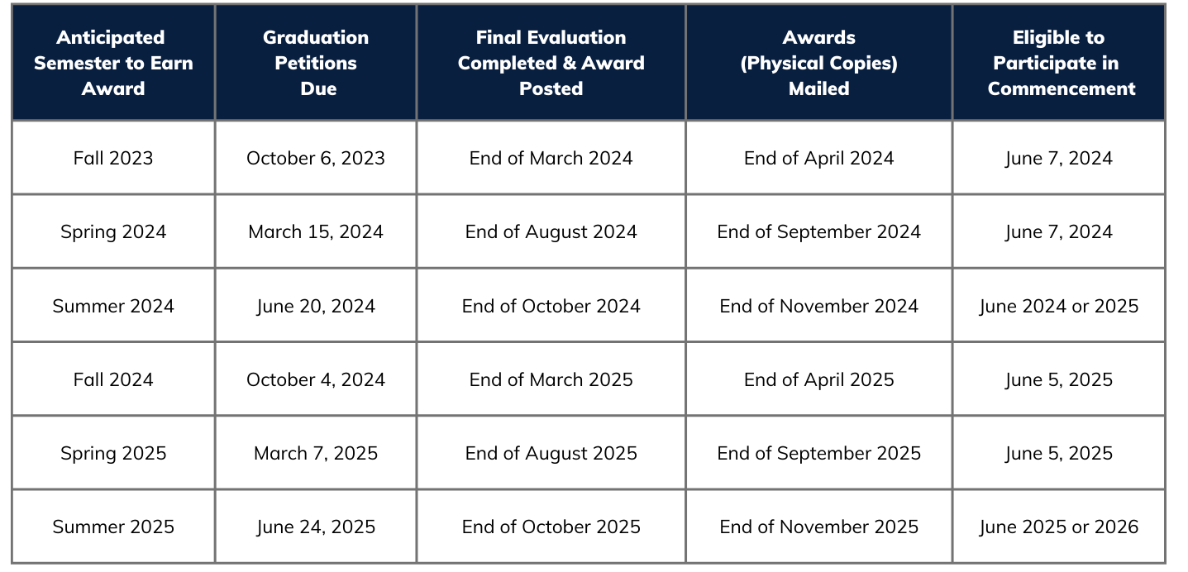
Processing Timelines

Slide 7
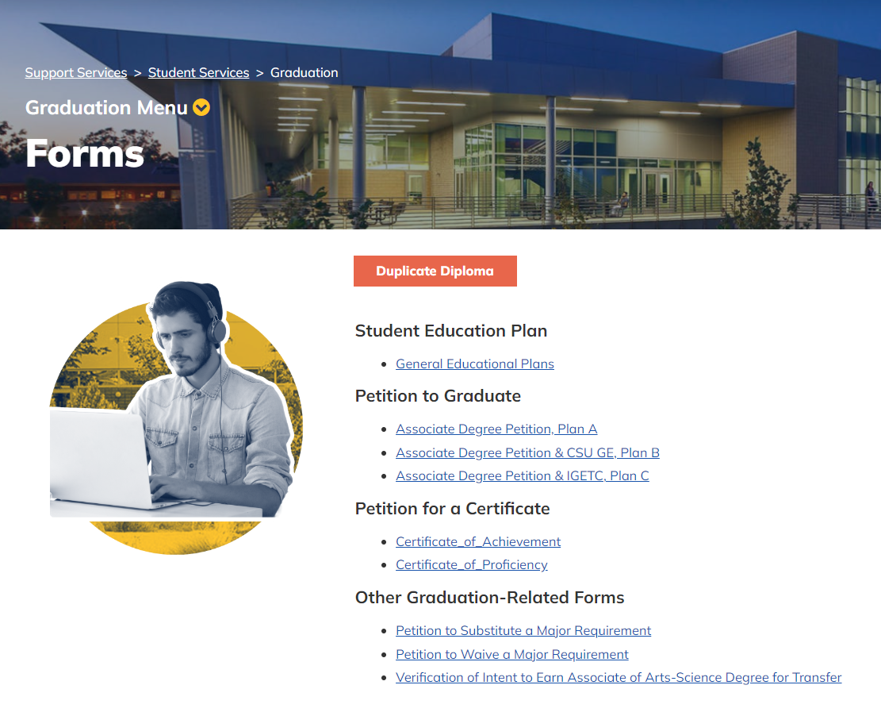
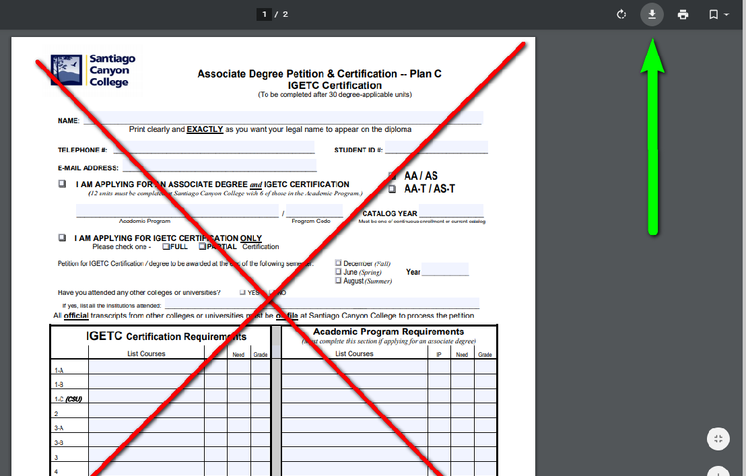
Download and Save
Graduation Website www.sccollege.edu/graduation
Click on Forms

Slide 8
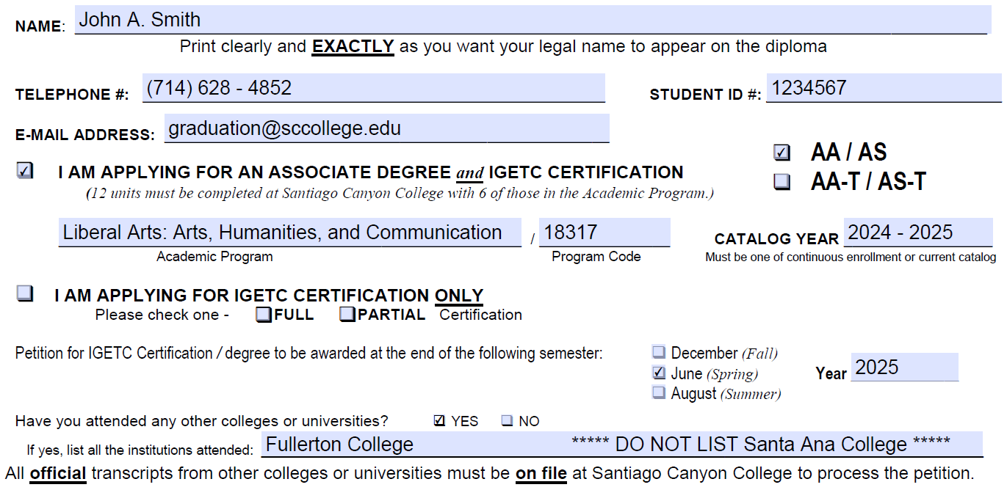
Completing the form: TOP

Slide 9
Completing the form: MIDDLE
2024 – 2025 Catalog
www.sccollege.edu/catalog
Transcripts
Self-Service > Academics > Unofficial Transcript

Slide 10
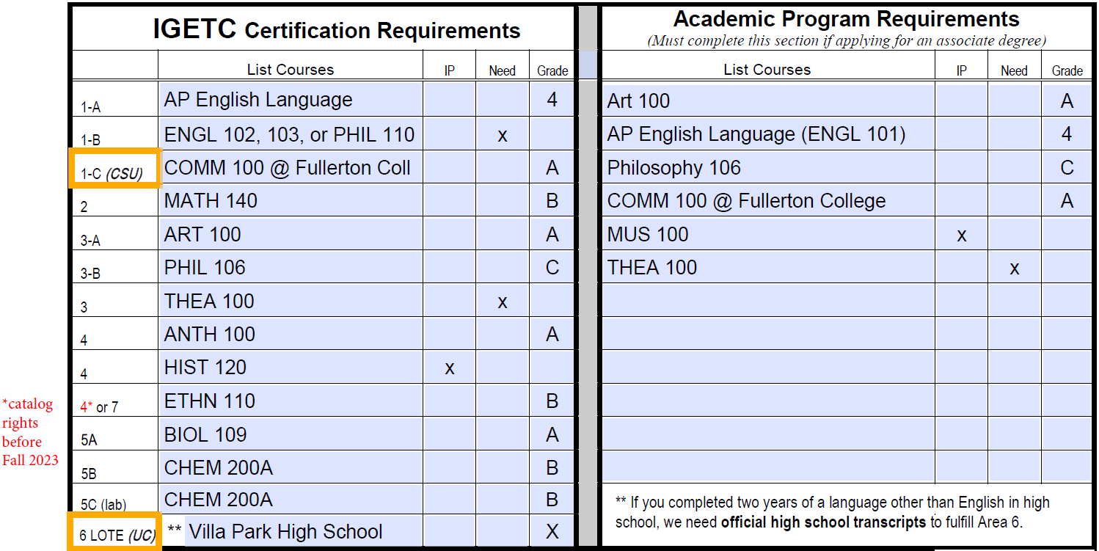
Completing the form: MIDDLE

Slide 11
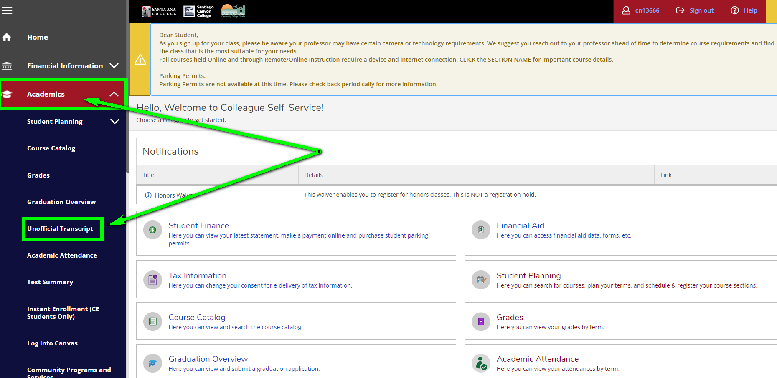
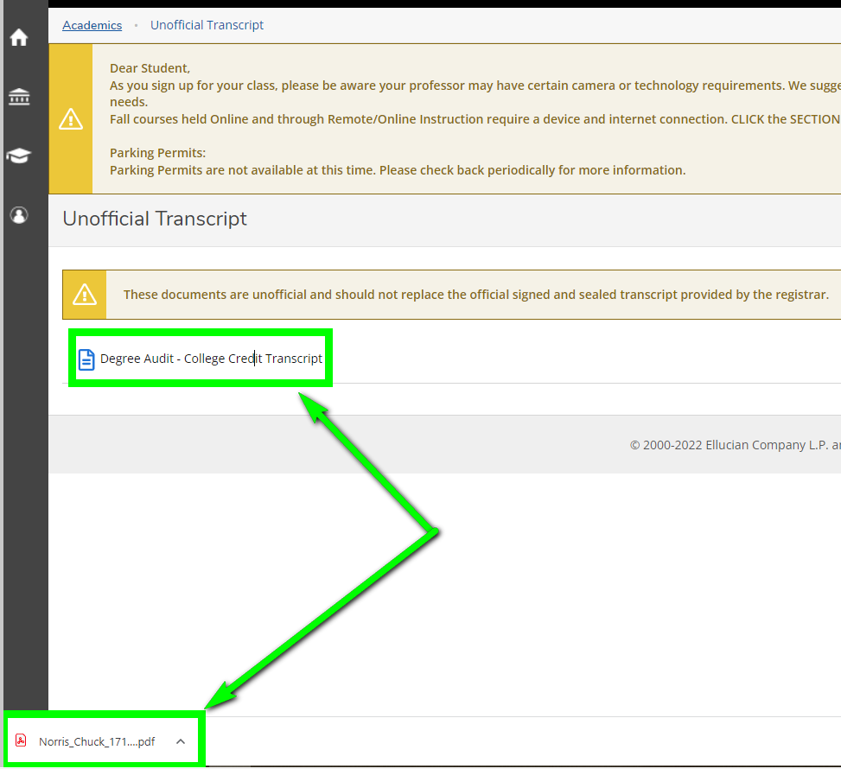
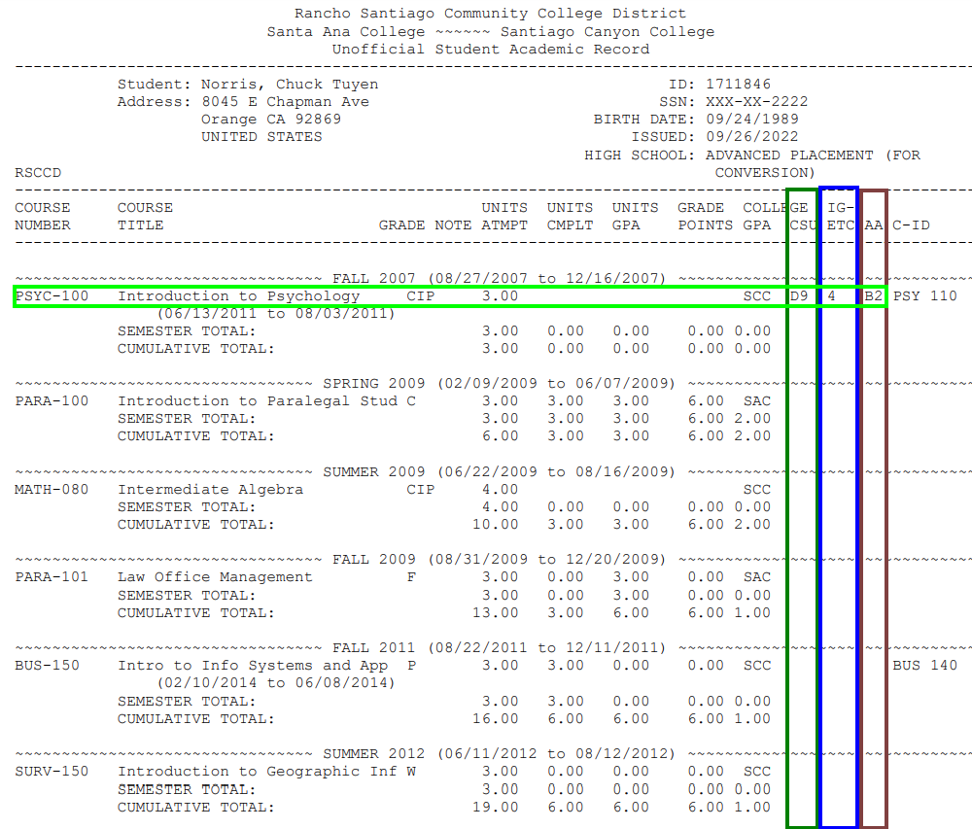
Completing the form: MIDDLE
LEFT SIDE – Certification Requirements / General Education

Slide 12
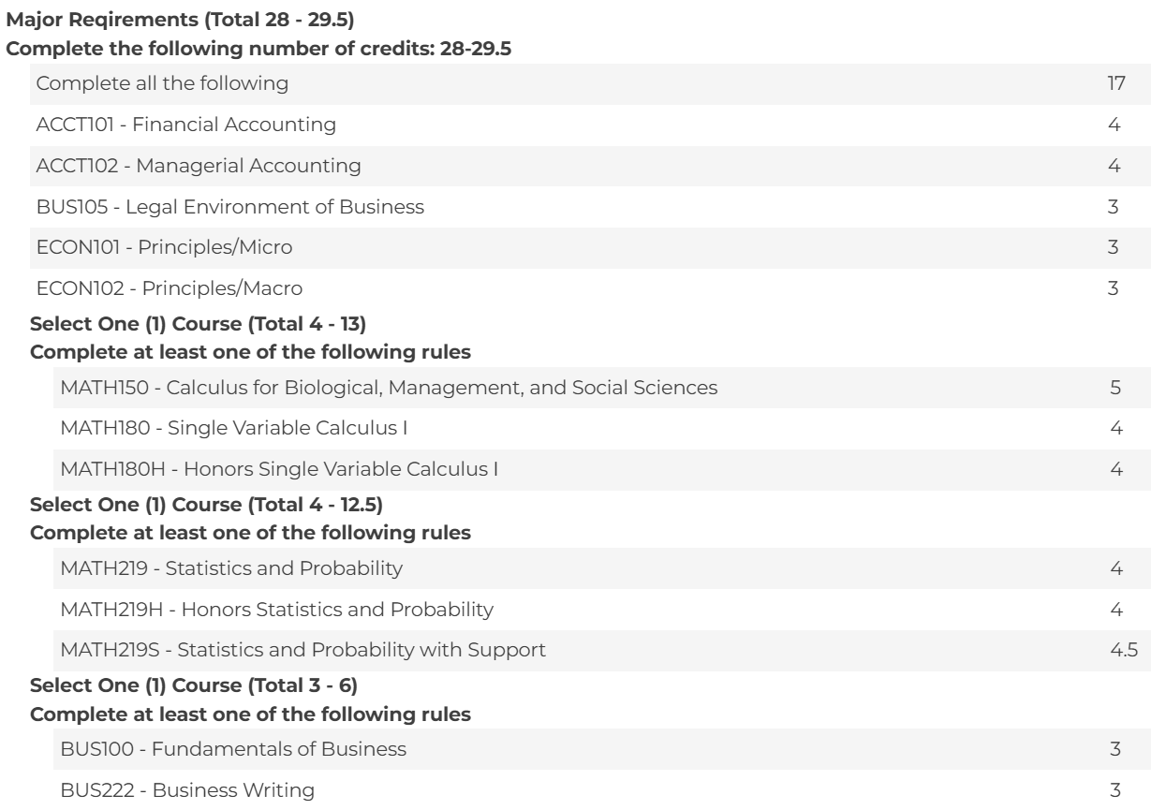
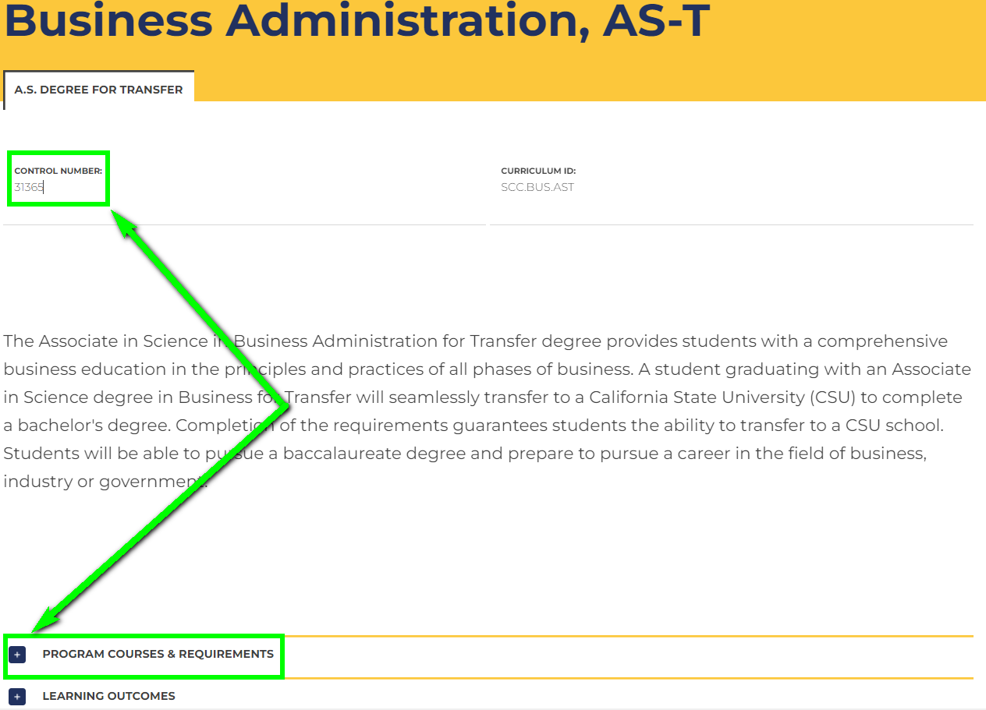
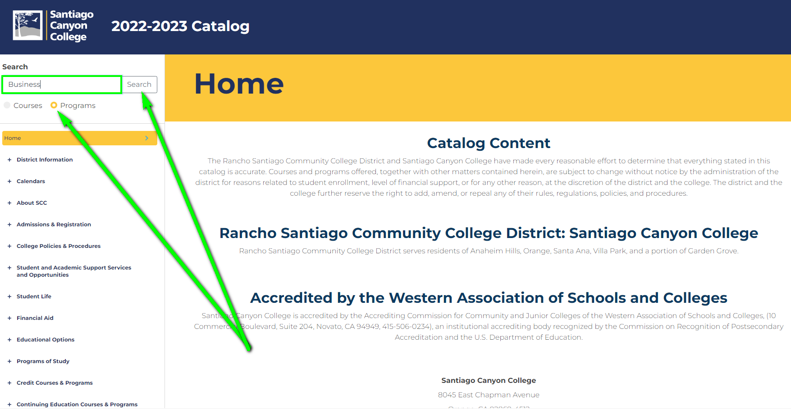
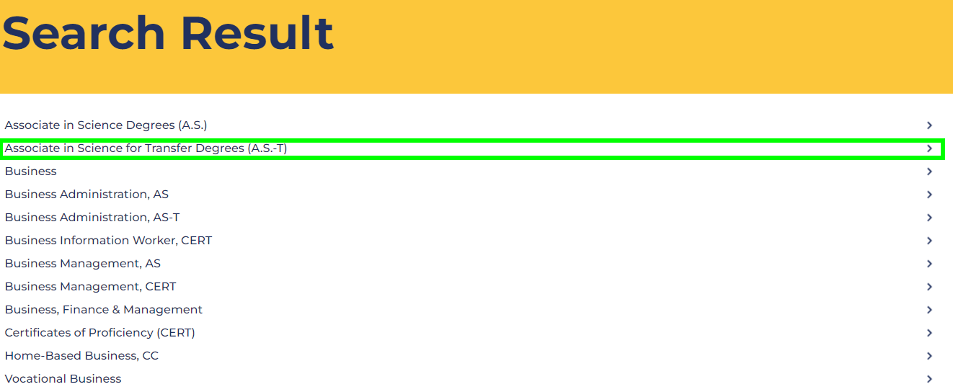
Completing the form: MIDDLE
RIGHT SIDE – Academic Program “Major”

Slide 13
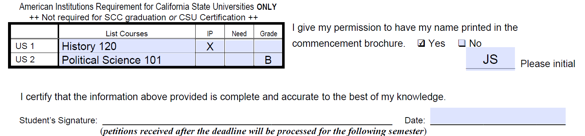
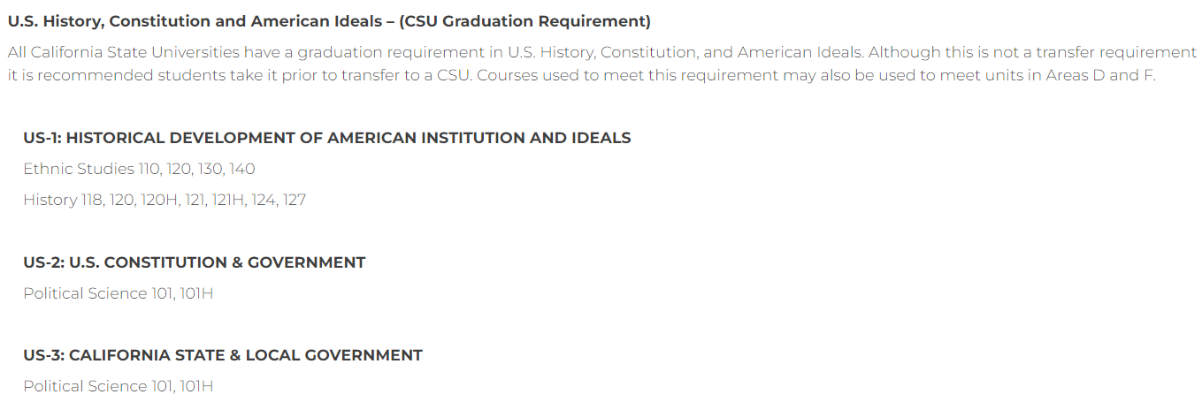
Completing the form: BOTTOM

Slide 14
Resources
Graduation Office, E-101
(714) 628–4852, Live-Chat, graduation@sccollege.edu
Counseling Office, D-106
(714) 628-4800, Live-Chat, Online Appt, counseling@sccollege.edu
Transfer Success Center, D-104
(714) 628–4865 or transfer_center@sccollege.edu​

